Slide 1
Subject: final r project topic: Lung Capacity of the individuals
By Group 5:
Aarish Salam Memon
Ananya Siddesh
Baptiste Lorenzato

Slide 2
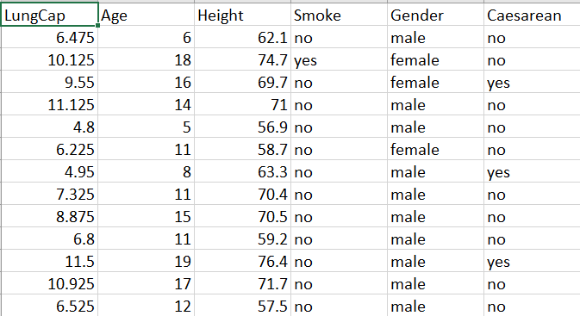
Background of the dataset
This data set shows the lung capacity of the each individual according to the following parameters “Lung Capacity, Age, Height, Smoke, Caesarean And Gender.
This Dataset has 6 Variables 725 Observations.

Slide 3
Background of the dataset Variables
Lung Capacity – It’s the Lung Capacity of a person
Age – It’s how old is the person
Height – How tall the person is
Smoke – If the person is a smoker or not
Gender – If the person is male or female
Caesarean – If they’re born by caesarean

Slide 4
Purpose of the Project
Predicting the caution of lung capacity based on the different parameters
Understanding the Lung Capacity of each individual.

Slide 5
Data Preparation and Analysis
Dimensions: There are 725 rows and 6 columns
Finding out the missing values
There are no duplicate values found in the data set
There are no null vales in the data set.
We have represented the 3 bar plot and 3 histogram for the following data set.

Slide 6
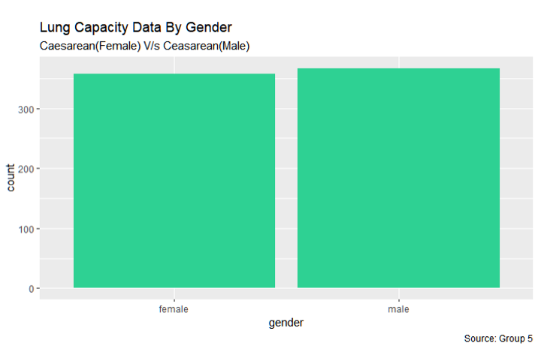
Plotting the Data Accordingly (PLOT # 1)
The Data in Gender Column has two options only “Male” and “Female” and as we can see that the ratio is almost equal, male is slightly higher than female.

Slide 7
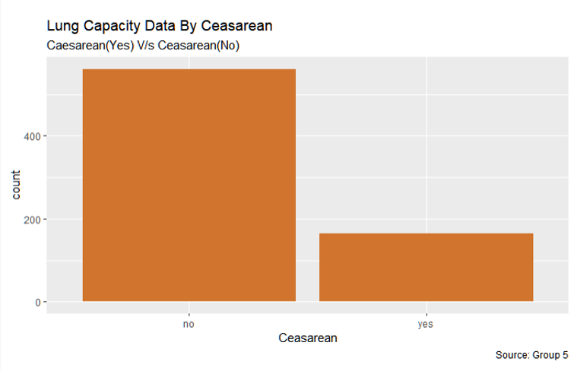
Plotting the Data Accordingly (PLOT # 2)
The Data in Caesarean Column has two options only “Yes” and “No” and as we can see that the ratio has a difference. There are more number of individuals in the non smoking category.

Slide 8
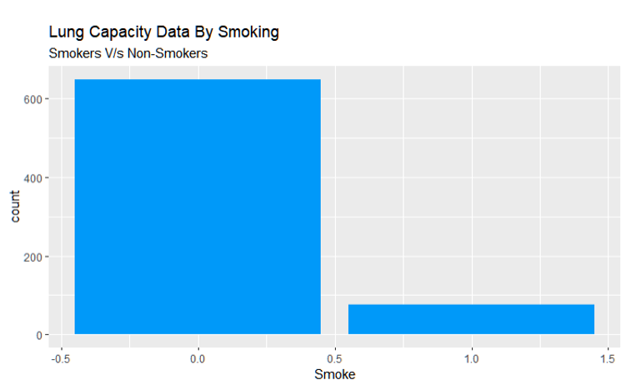
Plotting the Data Accordingly (PLOT # 3)
The Data in Smoke Column has two options only “Yes” and “No” and as we can see that the ratio has a difference, No is higher than Yes.

Slide 9
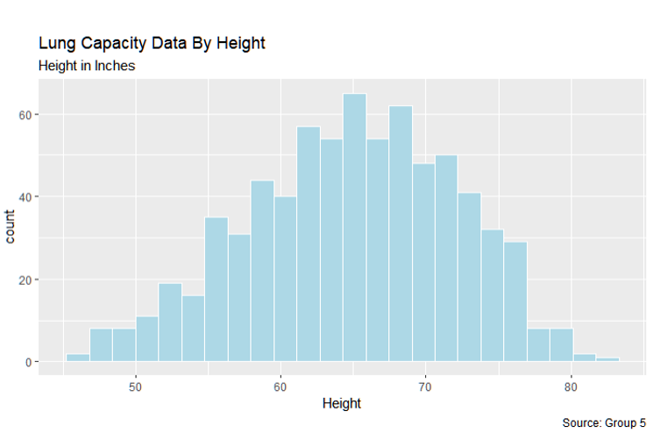
Plotting the Data Accordingly (PLOT # 4)
The Data in Height Column has Height in inches for every individual, this visualization represents that we have a good variety in height attribute.

Slide 10
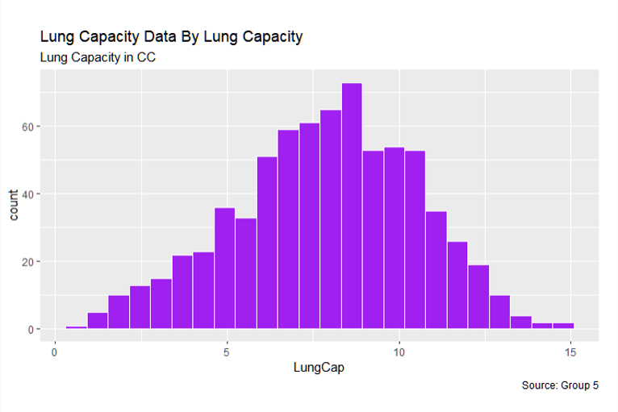
Plotting the Data Accordingly (PLOT # 5)
The Data in Lung Capacity Column has Lung capacity in CC for every individual, this visualization represents that we have a good variety in lung capacity attribute.

Slide 11
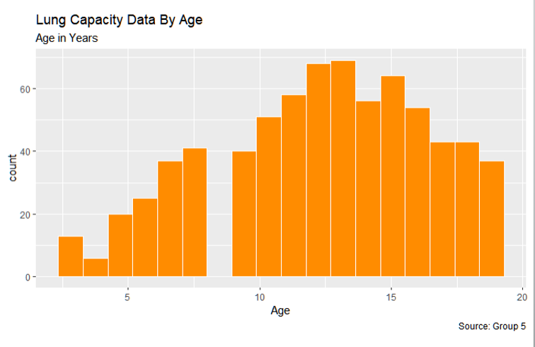
Plotting the Data Accordingly (PLOT # 6)
The Data in Age Column has Age in Years for every individual, this visualization represents that we have a diverse population of different age groups in Age attribute.

Slide 12
PART – 2 Exploratory Data Analysis Data Analysis using Box plot and Histogram
1. First Analysis is done on three columns of dataset and that are (Lung Capacity, Age, Smoke) we have first divided the age into three groups of 0-9,10-16,16+ and analyzed the lung capacity of the age groups if they are smokers or non-smokers. Based on the results we have given that a visual representation of box plot and histogram.
2. Second Analysis are done between the gender and the lung capacity of the individual. Based on the results we have given that a visual representation of box plot and histogram.

Slide 13
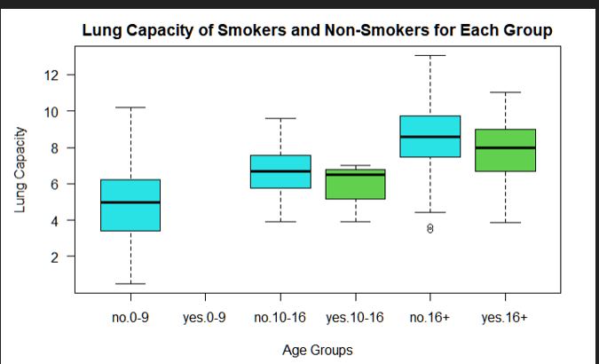
Data Analysis # 1(Box Plot)

Slide 14
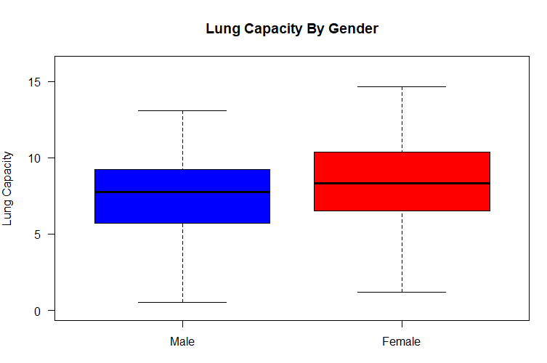
Data Analysis # 2 (Box Plot)

Slide 15
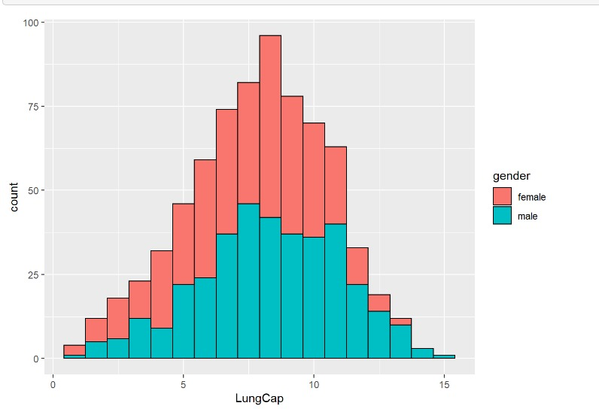
Data Analysis # 2 (Histogram)

Slide 16
Part – 3 Hypotheses testing:
In the hypothesis we are covering 2 main questions:
1. Lung Capacity of Smokers and Non-Smokers is equal or not?
2. Lung Capacity of both the genders male and female is equal or not?
WE have conducted two test for the following questions.
T test we have done for the two questions to find the mean difference two variables.
F test we have done for the two questions to find the variance two variables.
After analysing the hypothesis testing we get the conclusion whether to accept or reject the null hypothesis or to accept or reject the alternative hypothesis or to

Slide 17
Part – 4 Linear Regression:
We try to understand which parameters affect the lung capacity
We split the dataset (80:20) between training and test
We did a subset selection using forward, Backward and both direction
All 3 gave the same result as for which parameters are significant
All 3 gave the same MAE and MSE

